Slide 1





HEALTHCARE PROJECT
COVID19 VACCINE
REGISTRATION SITE

Slide 2

GROUP
MEMBERS
Utkarsh kumar
Abhishek kumar Singh
20BCS9495
20BCS9458
Priyanshu Vaishnav 20BCS9461
COVID-19 | 2020

Slide 3

CONTRIBUTION
HTML and Design – Utkarsh kumar (20BCS9495)
CSS and Login functionality – Abhishek kumar singh (20BCS9458)
DBMS ,Backend and Connectivity– Priyanshu vaishnav (20BCS9461)

Slide 4
IDEOLOGY
Health is the most important thing and due to the present situation, we all can understand it as we are working and studying from home since last 2 years.
Now that the situation is returning to normal but we should not be careless about it, the threat of covid is not completely over yet. Having a complete information about the people around us are vaccinated or not and maintaining the all rules and regulation is our responsibility. Our project will make this task much easier and help everyone to stay safe.
COVID-19 | 2021

Slide 5
OUR VISION
We aim to design and create a data management system that will store the data of all the people who are vaccinated with the prevention vaccine of Covid.
This will include a form to be filled by people which will provide us with the information of vaccinated people in the vicinity.
Anyone with an account can form and view the data whereas only the admin has the authority to delete the data. The software, of this vaccination, has a very user-friendly and simplistic interface.
In the dashboard, there are also options to view the stats of the people vaccinated out of the total.
COVID-19 | 2021

Slide 6







TECHNOLOGY USED
HTML CSS
JAVASCRIPT PHP
MYSQL
COVID-19 | 2021

Slide 7

THUS THE SYSTEM PROVIDES A 100% AUTOMATED SYSTEM TO COLLECT THE DATA OF PEOPLE.

Slide 8
FEATURES
Login Functionality
Register Functionality
Fill up a form
Check available Slots for Vaccine
Read Blogs related to Covid
Access FAQs
Add or Delete data from the database
Delete User accounts

Slide 9

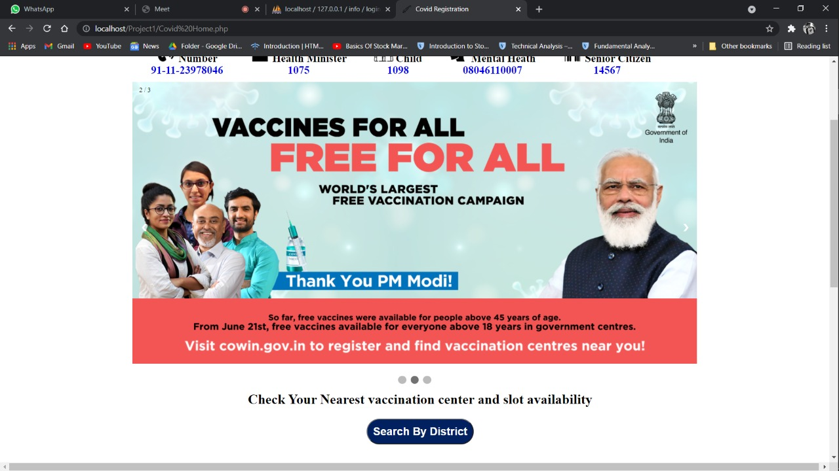

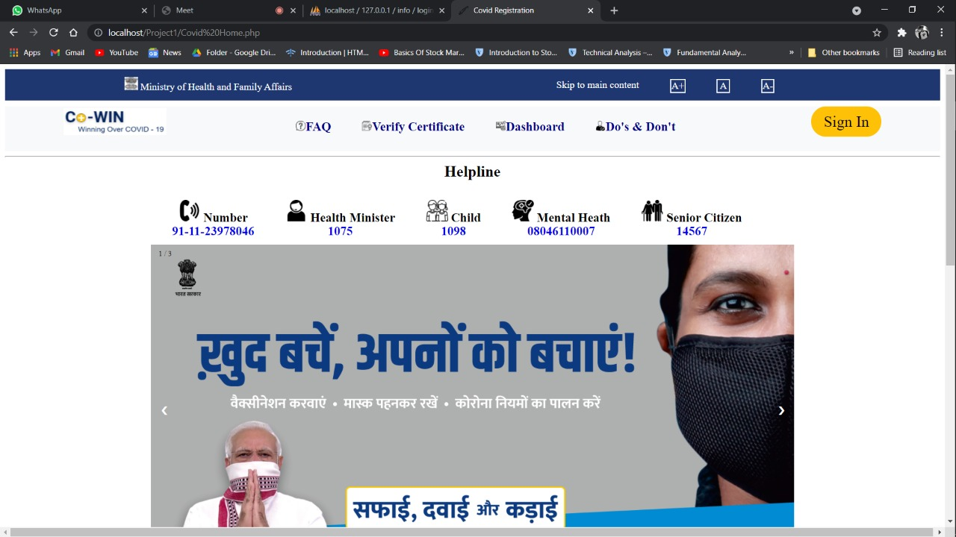


WORKING SNAPSHOT

Slide 10
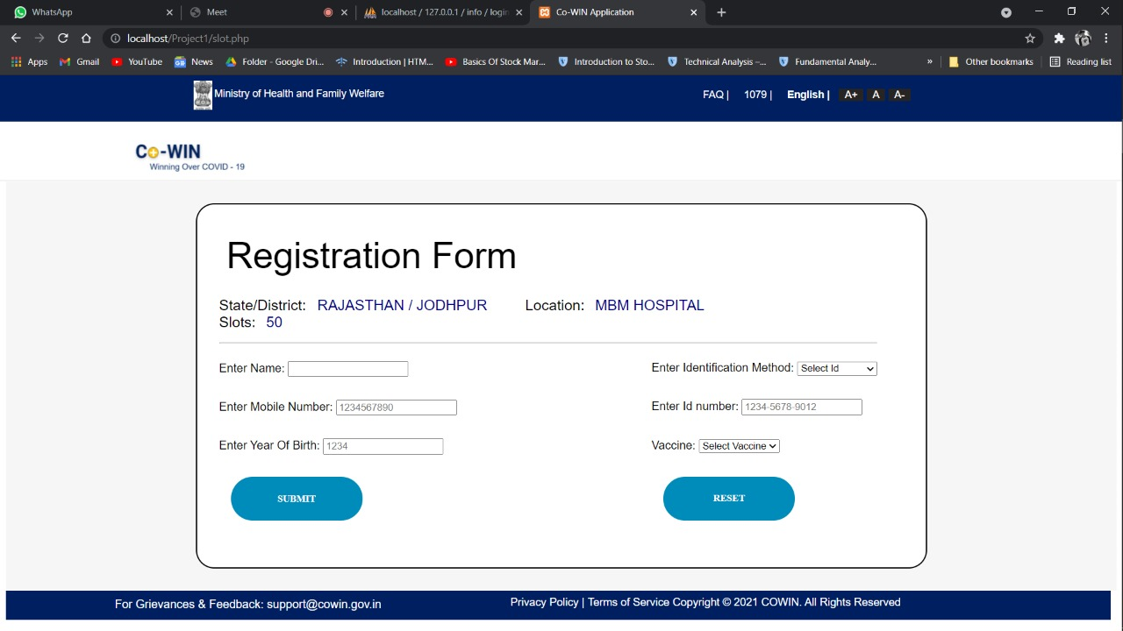
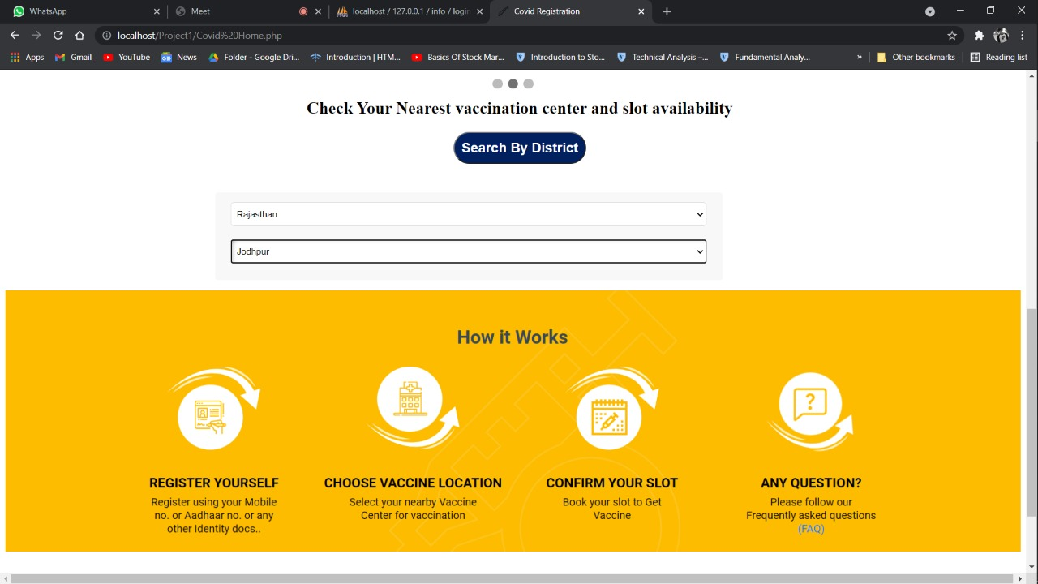
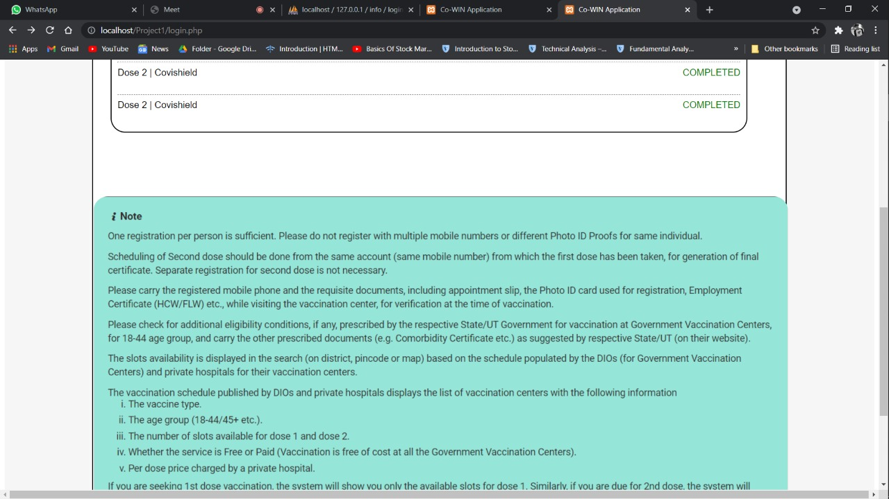

WORKING SNAPSHOT

Slide 11
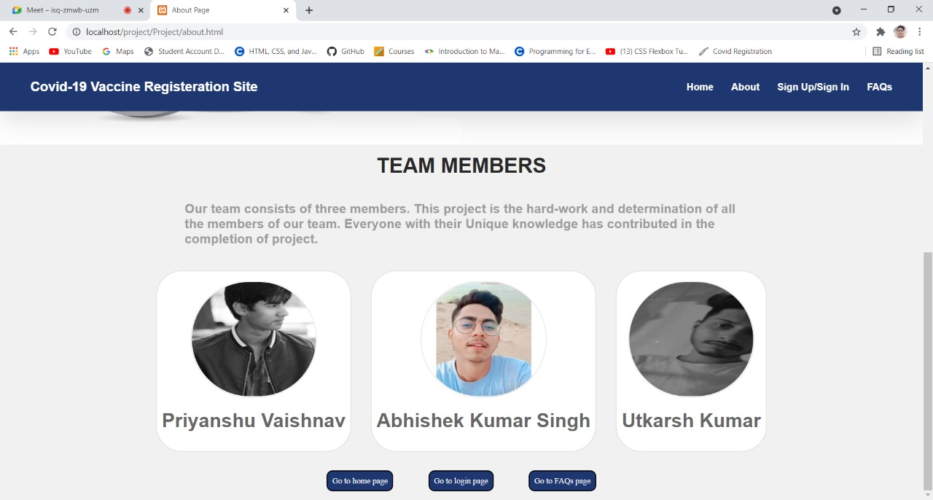
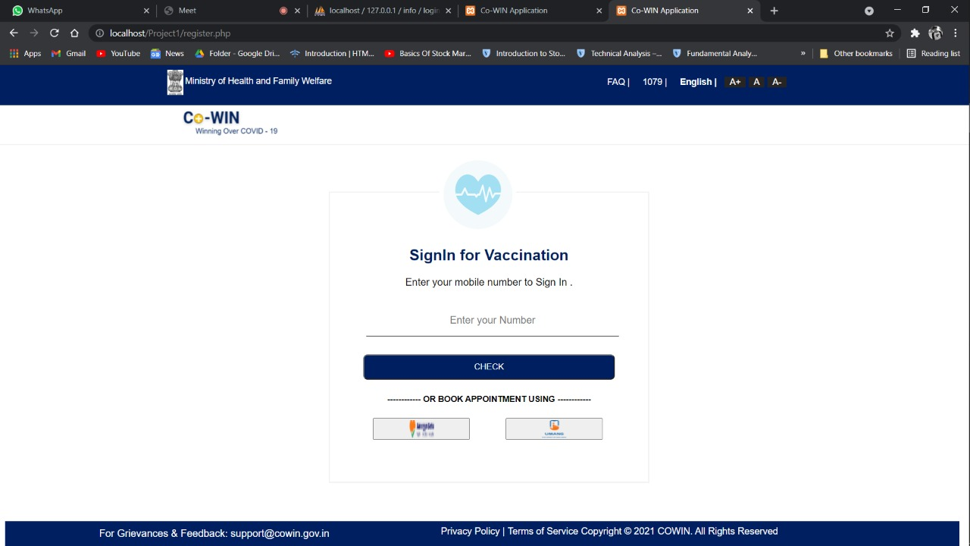
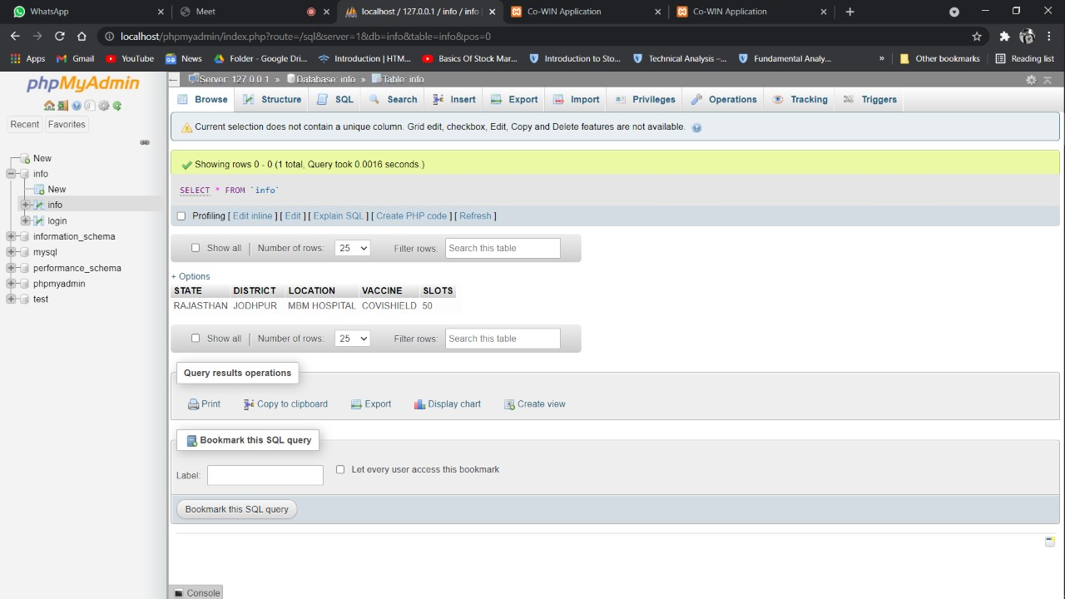
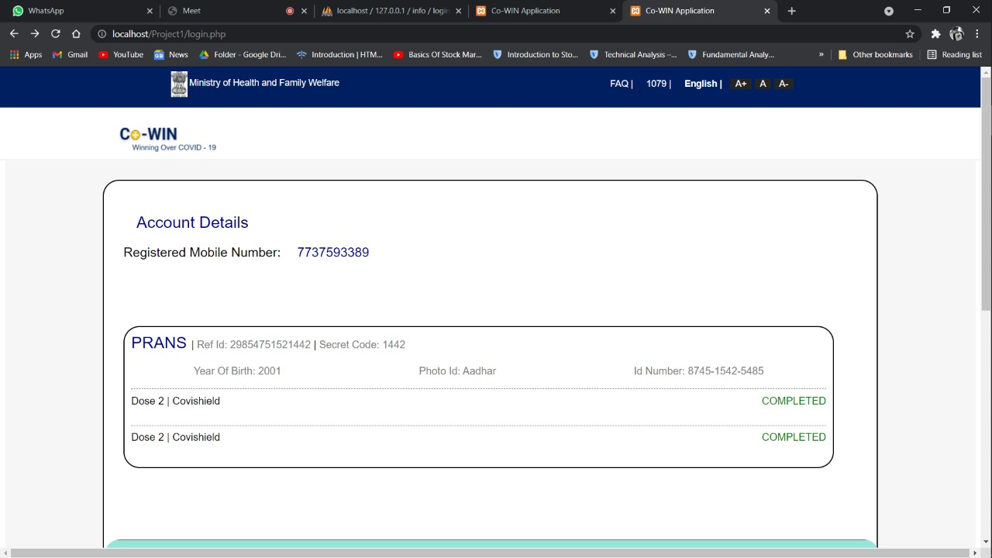
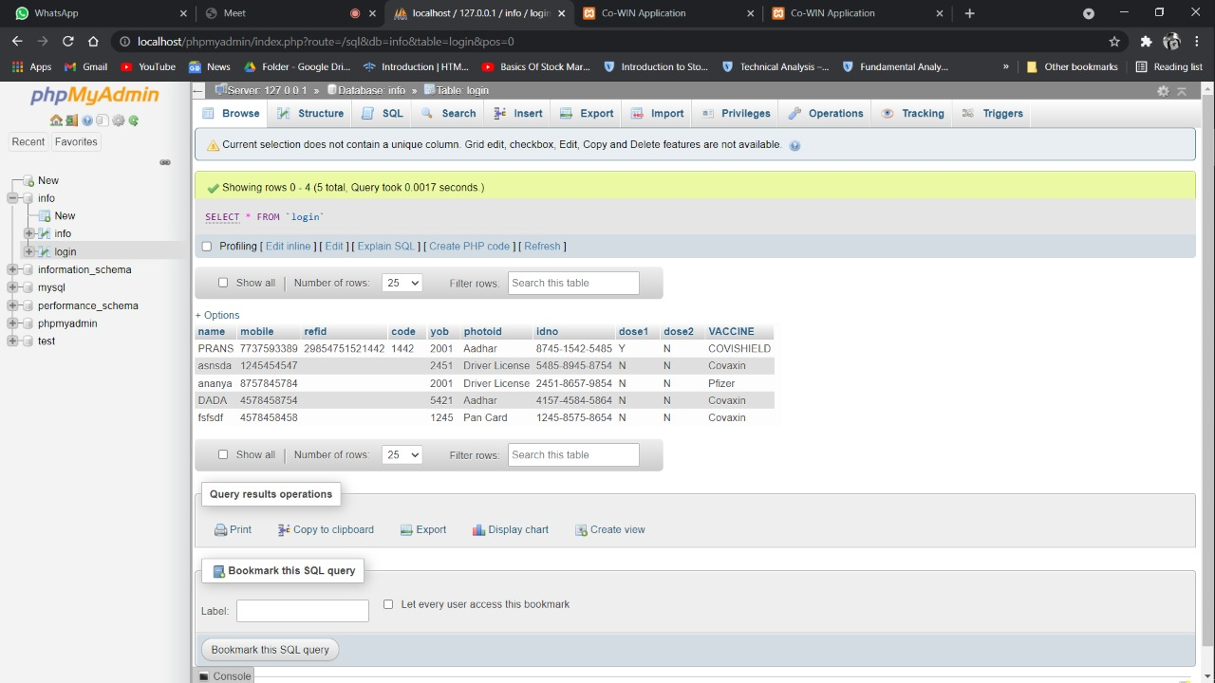
WORKING SNAPSHOT

Slide 12
CONCLUSION
The project is only a humble endeavor to satisfy the client's needs for managing their project work. Several user-friendly coding has also been incorporated. The goal of software planning is to establish a framework for completing projects within a limited timeframe at the beginning of the project.
Therefore, after implementing all the mentioned libraries as well as software tools, we finally full-fledged website where users can make an account, log in and also post their vaccination data whenever they want.

Slide 13


